Slide 1
Input/Output

Slide 2
CPU-I/O Device Communication
I/O-mapped I/O: Also called Port-mapped I/O
Memory mapped I/O
Point | I/O-mapped I/O | Memory-mapped I/O
Address space | Separate | Same as memory
Instructions | Special (IN, OUT) | Same as memory (LOAD/STORE/MOV)
Compatibility | Older systems | New systems

Slide 3
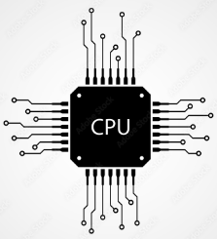
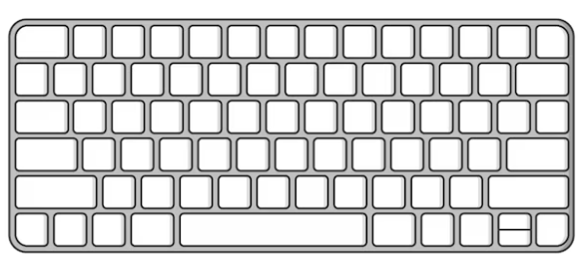
Interrupt-Driven I/O (User Presses a Key)
Keyboard: Generates an interrupt
CPU: Stops what it is doing and runs an Interrupt Service Routine (ISR)
ISR: Communicates with the keyboard controller to read the keypress data (typically a scan code)
CPU: Stores the data in a CPU registers or memory buffer
CPU: Resumes its previous tasks after handling the keypress
Interrupt
ISR
Scan code
Keyboard controller

Slide 4
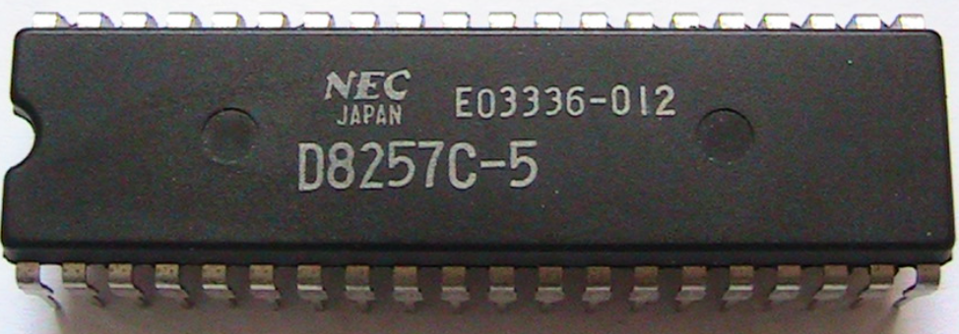
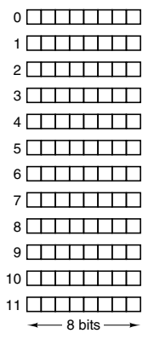
Direct Memory Access (DMA)
Keyboard: Generates an interrupt
DMA controller: reads keyboard data
DMA controller: Directly transfers data into a designated memory address
CPU: Notifies the CPU when the transfer is complete
CPU: Reads keyboard data from memory and acts on it
Interrupt
W
r
i
t
e
Notify

Slide 5
Redundant Array of Inexpensive/Independent Disks (RAID)
Problem: CPU performance has constantly improved (Now in ns), but not that of disks (still in ms)
Solution: Parallel I/O
Term: Redundant Array of Independent/Inexpensive Disks (RAID)
How? Combine multiple physical hard drives into a single logical unit
Aim: Improve data reliability, availability, and performance
Techniques: Data striping, Mirroring, Parity techniques
RAID level: Decides features

Slide 6
RAID Levels
RAID 0: Striping without redundancy, primarily for performance improvement
RAID 1: Mirroring for data redundancy
RAID 5: Striping with distributed parity for a balance of performance and redundancy
RAID 10 (or RAID 1+0): A combination of mirroring and striping for high performance and redundancy
RAID 6: Similar to RAID 5 but with dual parity for enhanced fault tolerance.

Slide 7
Striping
Data striping: Break data into small blocks and distribute them across multiple drives
Use: Enhance read and write performance
Drawback: No redundancy
A1
A4
B3
A2
B1
B4
A3
B2
Disk 1
Disk 2
Disk 3

Slide 8
Mirroring
Mirroring: Two identical drives store the same data
If one drive fails, the data is still available on the other drive
Full redundancy, but slow performance
Mirroring
Block 1
Block 2
Block 3
Block 1
Block 2
Block 3
Disk 1
Disk 2

Slide 9
Parity
Parity: Redundancy without requiring the same amount of storage as mirroring
Example: Suppose we have three disks
Data is spread on Disk A and B (Data 1 and 2)
Disk C will have Parity = D1 XOR D2
Suppose we have a problem: Disk A fails => D1 is lost
Solution: Retrieve D1 = Parity XOR D2
How possible? XOR property: If A XOR B = C then A = B XOR C
Disk A (Data 1)
Disk B (Data 2)
Disk C (Parity)

Slide 10
CISC (Complex Instruction Set Computer) versus RISC (Reduced Instruction Set Computer)

Slide 11
CISC versus RISC
CISC: Fetch->Decode (and Interpret)->Execute
RISC: Fetch->Decode->Execute
More Important: How many instructions we can start at the same time
Less important: How much time a single instruction requires
Fetch = Slow, Execute = Fast
Reason: Fetch = CPU + Memory , Execute = Generally within the CPU

Slide 12
CISC versus RISC
ADD A, B, C
Single instruction
Added interpretation step
Requires many internal sub-instructions
Takes multiple clock cycles
Less work for the programmer
More work for the processor
LOAD X, A
LOAD Y, B
ADD Y, X
STORE Z
Each instruction needs one clock cycle
More work for the programmer
Less work for the processor

Slide 13
RISC Philosophy
All instructions are directly executed by the hardware
Maximize the rate at which instructions are issued
Instructions should be easy to decode
Only LOAD and STORE instructions should use memory
Provide a lot of registers

Slide 14
The ARM Architecture
1980: A group at Berkley designed a VLSI chip with a design different from the CISC architecture – They called it RISC
1981: A group at Stanford created MIPS
In 1985, the U.K.-based company Acorn Computer, created the Acorn Archimedes personal computer
ARM = Advanced RISC Machine … Now
ARM = Acorn RISC Machine … Earlier
They called their design the Acorn RISC Machine
Other RISC architecture examples: MIPS, PowerPC, and RISC-V

Slide 15
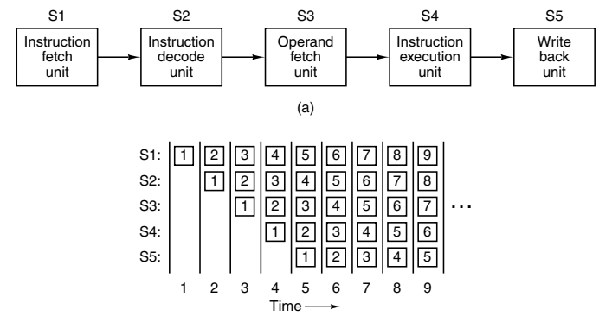
Instruction-level Parallelism: Pipelining
Pipelining: Instead of Fetch-Decode-Execute, create smaller stages even inside them and use different piece of hardware for them

Slide 16
Instruction Execution in a Pipeline
T1 | T2 | T3 | T4 | T5 | T6 | T7 | T8 | T9
…
Opcode | Decode | Address | Values | Compute | Store
Instr 1
Opcode | Decode | Address | Values | Compute | Store
Instr 2
Opcode | Decode | Address | Values | Compute | Store
Instr 3
Etc

Slide 17
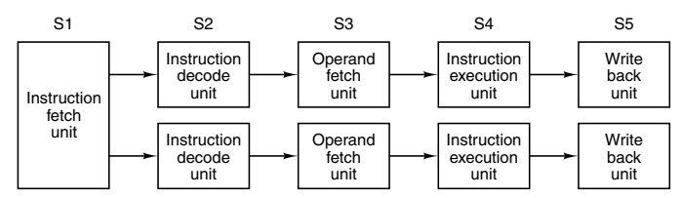
Instruction-level Parallelism: Superscalar Architecture
Superscalar architecture: Create more than one pipeline, called dual pipeline CPU

Slide 18
Processor-level Parallelism
To be discussed separately in Parallel Computing

